Slide 1
E-Safety – Cowbridge
Safeguarding young people on the internet
and
related technologies.

Slide 2
E-Safety
What risks should we be guarding against?
Following information from the EUKids online project

Slide 3
What risks should we be guarding against?
Notes:
Young person receiving information they may or may not have asked for
Commercial – may be unsuitable or ask for personal information
Aggressive – lots of YouTube clips on street assaults, sporting and traffic accidents, etc. De-sensitisation.
Sexual – even on YouTube if settings aren’t set properly.
Values - issues with radicalisation, racial and religious intolerance, gender attitudes,
FAKE News
Questionable value – body image, anorexia websites

Slide 4
What risks should we be guarding against?
Notes:
Tracking - location, e.g. find iPhone
Personal Data on valid (Google) and invalid sites
Cyberbullying is a bullying using electronic forms of contact. Bullying or harassment can be identified by repeated behaviour and an intent to harm and can include posting rumours about a person, threats, sexual remarks, disclose victims' personal information, or pejorative labels (i.e., hate speech). (Wikipedia 2017)
Child grooming is befriending and establishing an emotional connection with a child, and sometimes the family, to lower the child's inhibitions for child sexual abuse. It lures minors into trafficking of children, illicit businesses such as child prostitution, or the production of child pornography. (Wikipedia 2017)
Self harm websites

Slide 5
What risks should we be guarding against?
Notes:
Young person actually doing these
Illegal downloading – legailty (KODI boxes) , chance of viruses, possible costs in the future
Hacking – world wide so possibility of court case in, e.g. the US
Online gambling – addiction and costs
Ability to access world wide values – rise of ISIS through social media “the organization releases, on average, 38 new items per day—20-minute videos, full-length documentaries, photo essays, audio clips, and pamphlets, in languages ranging from Russian to Bengali”
Cyberbullying – child as the actor – bad words spoken in the real world disappear and are difficult to prove, once said on the web they can be there forever.
Sexting is sending, receiving, or forwarding sexually explicit messages, photographs or images, primarily between mobile phones. More of a problem than you would expect.

Slide 6
Not just a problem for now
Your Digital Profile/Footprint
Notes:
One of the things we emphasis is that once something is on the internet then it is difficult or impossible to remove.
This can cause problems for people in the future.

Slide 7
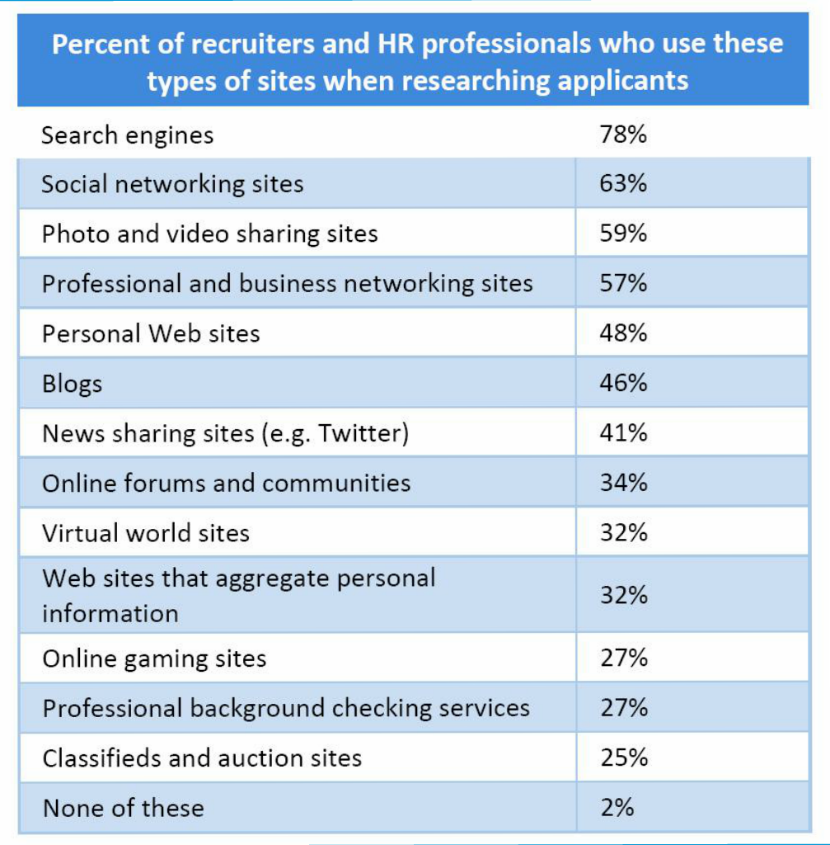

Slide 8
E-Safety
Approach adopted by the School

Slide 9
Teachers and other staff
All staff receive training in E-Safety
but a general guideline for Cowbridge staff
on being made aware of an E-Safety Issue:
Manage pupil well being (reassurance, support of victim).
Contact safeguarding officer immediately
If possible and legal, save evidence.
Notes:
Legality of saving/sending evidence – do not send it to someone else if sexual as it could be held against you.

Slide 10
Pupils
All pupils receive age appropriate training in keeping themselves safe:

Slide 11
“Rules” that we emphasise in Key Stage 3.
Never to agree to meet someone that you have met online. If you do not know the person in ‘real life’, tell your parents about anyone this is asking to meet you.
Do not give out personal information about yourself online without your parent’s permission. This includes your name, where you live or your telephone number.
Talk to your parents first about pictures you want to post online, whether they be of yourself or your friends and family members.
Do not respond to messages you receive that are mean or speaking meanly about others. Tell your parents about these messages.
Do not give out any of your passwords to friends or anyone you meet online.
Check with your parents first before downloading or installing any software on your computer.
Ensure privacy settings on activated on all of social media websites you use.
Always be kind of others online. Do not do anything that may hurt others including joining in conversations discussing other people’s problems.
Be careful about discussing details about your own personal problems with your friends online. It is better to speak to them in person. Tell your parents or teacher if you are struggling with something.
www.safesearchkids.com/internet-safety-tips-for-kids/#.WNjc9m_yvcs

Slide 12
Older Pupils – Social Media and Digital Footprint

